Slide 1


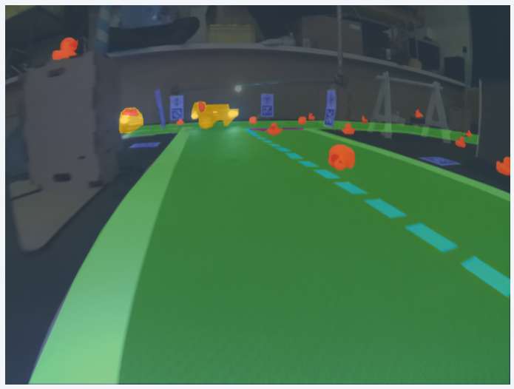
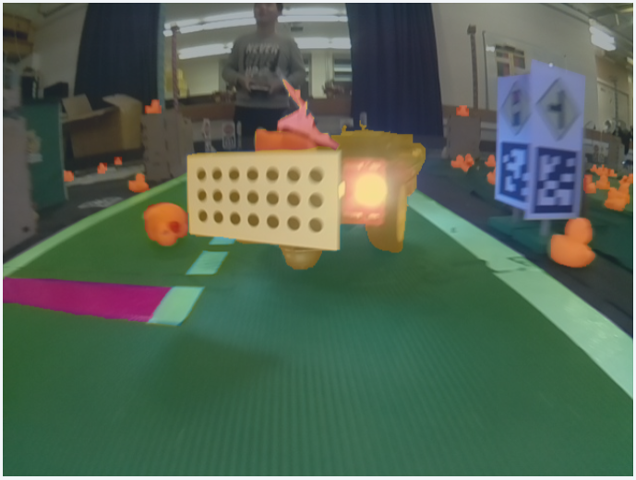
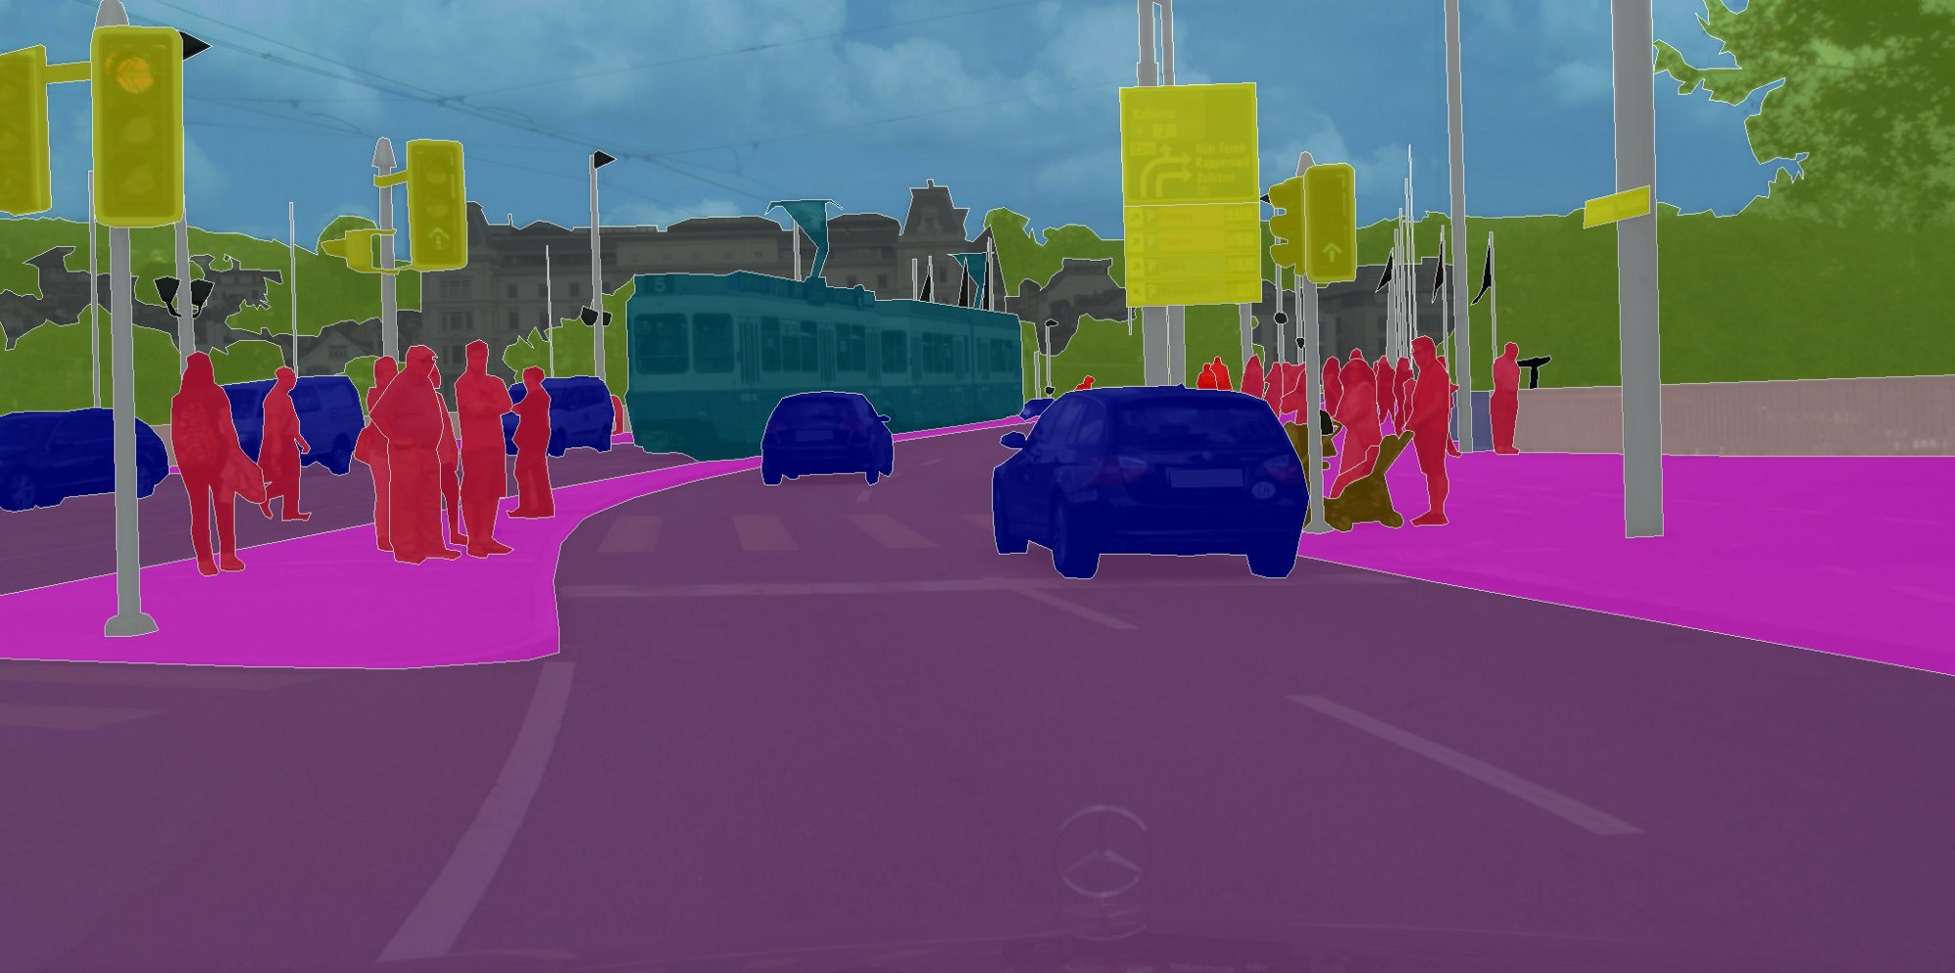
SemSeg: Semantic Segmentation
Edoardo Gabbi, Zijian Dong, Aoming Liu, Hanxue Liang
Light
Fast
Accurate
A
Task: label pixels based on the following classes:
Road
Background
Ducks
Duckiebots
Yellow / Red lines
Traffic signs

Slide 2
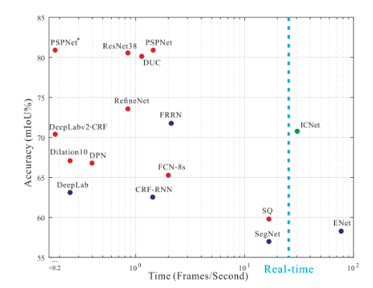
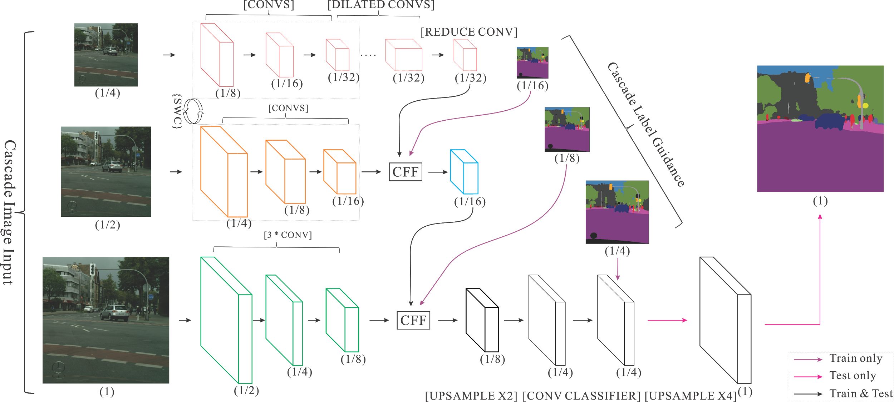
SemSeg: Approach
A
ICNet network
Cityscapes dataset

Slide 3
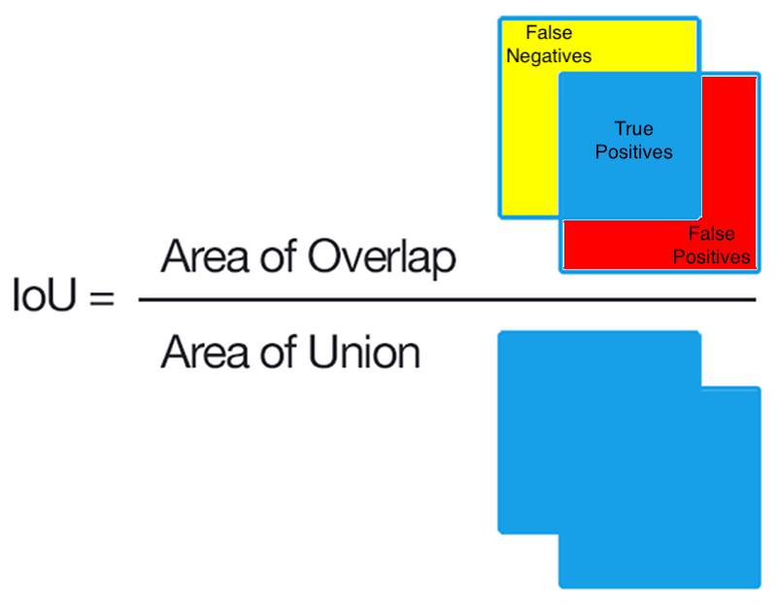
SemSeg: Performance
IoU (intersection over union)
Performance on Cityscapes database:
80.9 % IoU
Not evaluated on Duckietown
A
Weighted mean IoU, weights:
0.35 Road
0.15 Duckiebots
0.15 Duckies
0.1 Red and yellow lines
0.1 Traffic signs
0.05 Background

Slide 4
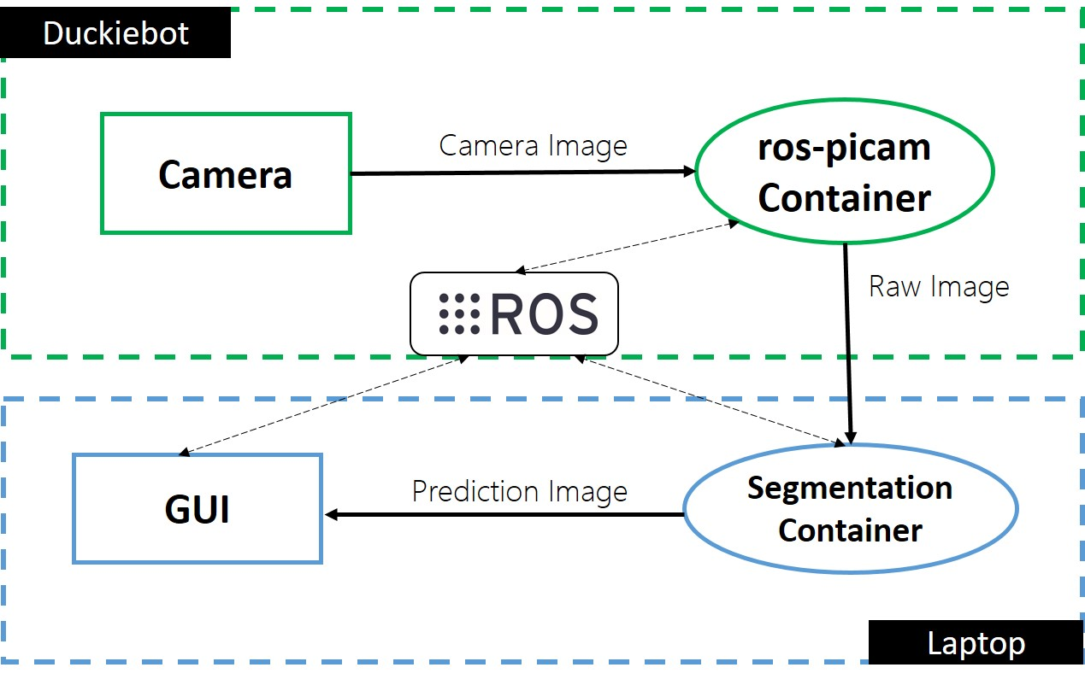
SemSeg: Demo
A

Slide 5
Semantic Segmentation: AIDO challenge
EVALUATOR
SOLUTION
Test Set
Ground Truth
For Image in Test Set:
Image
Performance
Evaluator
Algorithm
Submitted
Label
Public Score
Labels = [Label 1, Label 2, …. , Label n]

